Slide 1

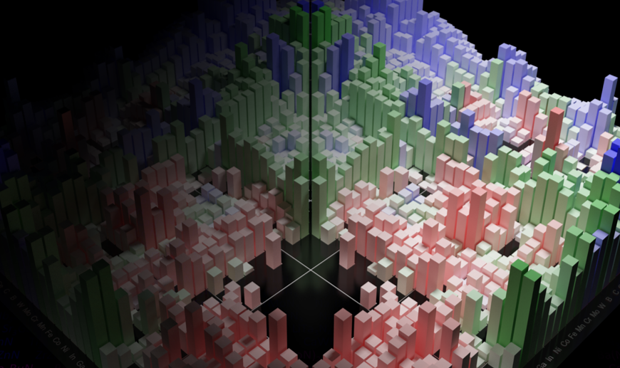
MSE 593 Data-Driven Materials Design and Genomics
Data-Driven Computational Materials Design:
Telling Data Driven Stories
Professor Wenhao Sun whsun@umich.edu
2023 Hokkaido Summer Insitute
Notes:
Syllabus Wenhao Sun
Set up Canvas – Katsuyo
Google Survey – Katusyo

Slide 2
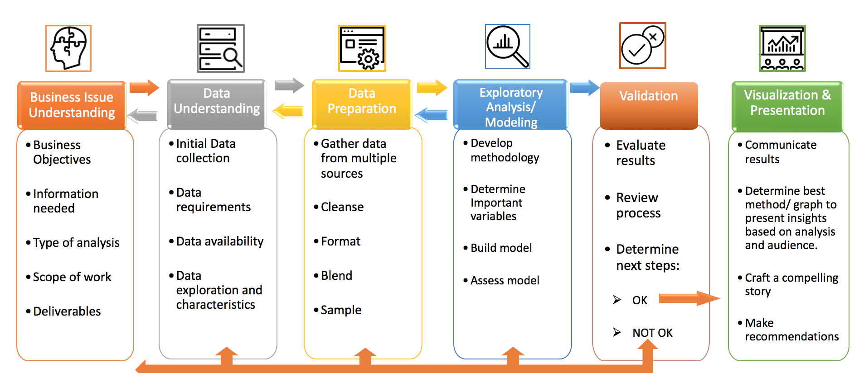
Materials Science and Engineering Version
of Crisp-DM
Materials
55%: Data Collection and Data Preparation
40% Analysis/Interpretation
5% Machine Learning

Slide 3
How do I know when to stop the data-exploration process?

Slide 4

How many of you have gone to an art museum?

Slide 5

Salvatore Mundi
Leonardo Da Vinci
c. 1500

Slide 6
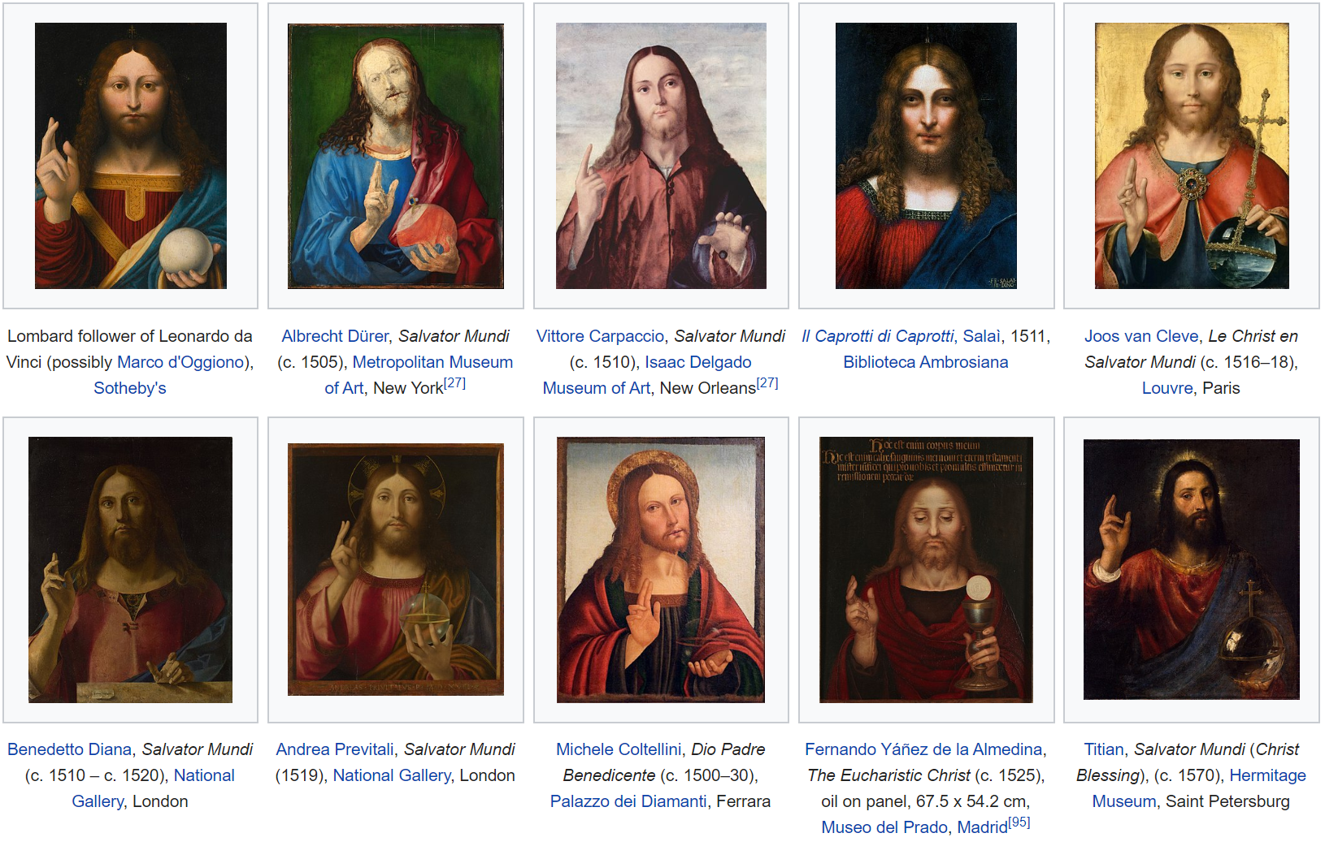

Slide 7
Salvatore Mundi
Leonardo Da Vinci
c. 1500

Slide 8


Slide 9
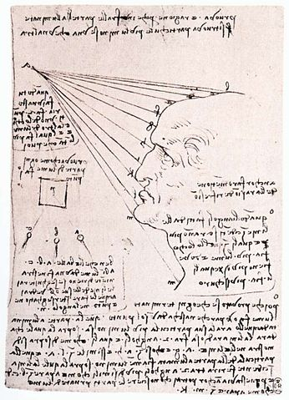
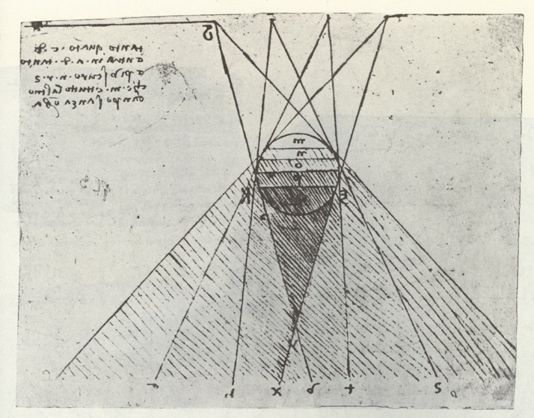

Slide 10

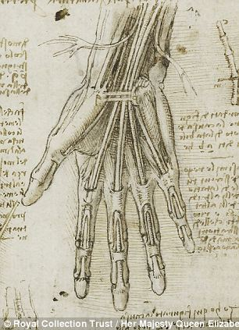

Slide 11


Slide 12
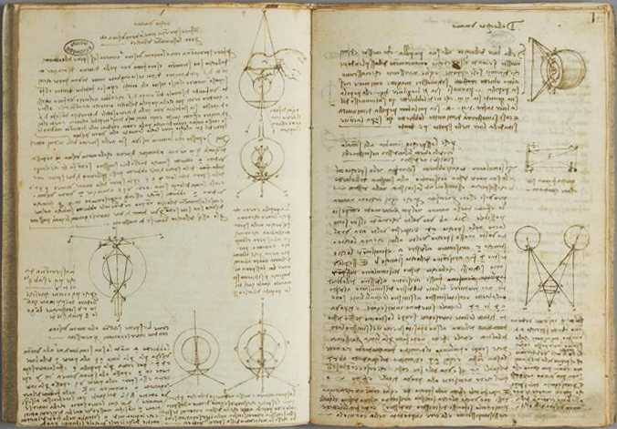

Slide 13


Slide 14
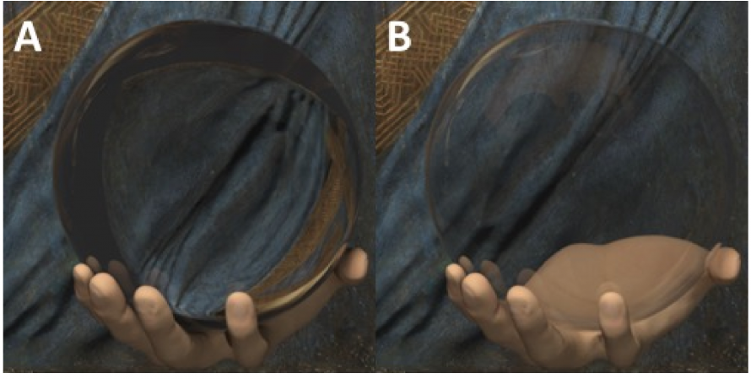
Real Sphere
Hollow Sphere

Slide 15
Salvatore Mundi
Leonardo Da Vinci
c. 1500

Slide 16
How do you create art?
Experience art.
Ask yourself: How did this make me feel? Did I like it? Did I not like it?
Why did you like it, or not like it?
Why did the creator decide to make it the way that they did? What was their objective?
How can I do this (or avoid this) in my own work?
The more art you experience, the better you will know what you like and don’t like.

Slide 17
How do you create science?
Experience science. (Read papers, Attend conferences)
Ask yourself: How did this make me feel? Did I like it? Did I not like it? Am I bored? Am I inspired?
Why did you like it, or not like it? Why is this boring/inspiring?
Why did the creator decide to make it the way that they did? What was their objective?
How can I do this (or avoid this) in my own work?
The more science you experience, the better you will know what you like and don’t like.

Slide 18
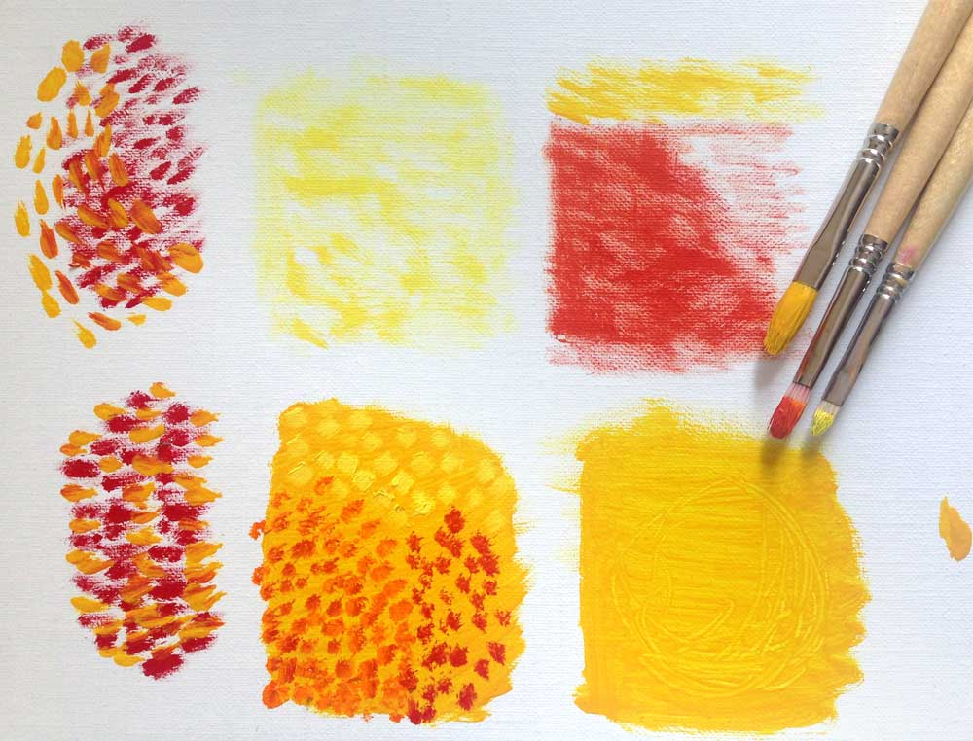

Learning machine-learning
Creating science
Attend an online class like Coursera, Udemy, or read ML forums
Look at the figure galleries of seaborn, plotly, scikit-learn. Try and understand what the figures are doing.
Read blogs and newsletters
https://towardsdatascience.com/data-science/home
https://citrine.io/newsletter-archive/ ← MSE specific
Read Papers
Subscribe to Journal Table of Contents Follow researchers you like on Google Scholar
3. Attend conferences

Slide 19
Visualize the answer
"The words or the language, as they are written or spoken, do not seem to play any role in my mechanism of thought. The psychical entities which seem to serve as elements in thought are certain signs and more or less clear images which can be 'voluntarily' reproduced and combined. .... This combinatory play seems to be the essential feature in productive thought before there is any connection with logical construction in words or other kinds of signs which can be communicated to others". Albert Einstein in a letter to Jacques Hadamard.

Slide 20
Visualize the answer
"Visualization - you keep repeating that", he (Feynman) said to another historian, Silvan S. Schweber, who was trying to interview him.
Feynman continues: "What I am really trying to do is bring birth to clarity, which is really a half-assedly thought-out-pictorial semi-vision thing. I would see the jiggle-jiggle-jiggle or the wiggle of the path. Even now when I talk about the influence functional, I see the coupling and I take this turn - like as if there was a big bag of stuff - and try to collect it in away and to push it. It's all visual. It's hard to explain."
Schweber: "In some ways you see the answer - ?"
Feynman: "The character of the answer, absolutely. An inspired method of picturing, I guess. Ordinarily I try to get the pictures clearer, but in the end the mathematics can take over and be more efficient in communicating the idea of the picture. In certain particular problems, that I have done, it was necessary to continue the development of the picture as the method before the mathematics could be really done."

Slide 21
Visualize the answer in data-science
What type of figure is best to represent my data?
Look at the figure galleries in seaborn, plotly, bokeh, scikit-learn.
Do any fit your needs? Do any inspire you?
- What axes should I plot against what?

Slide 22
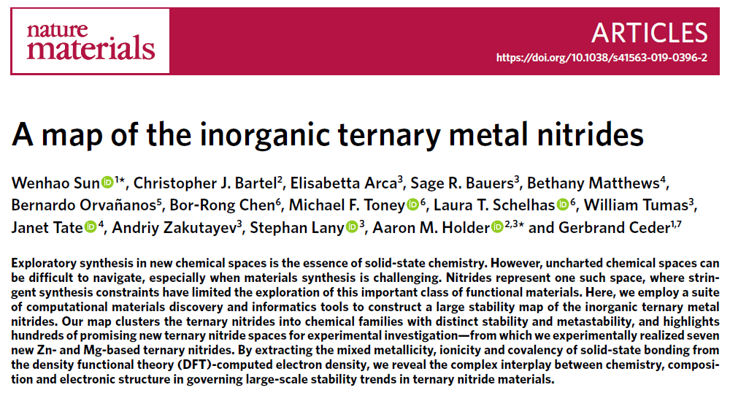

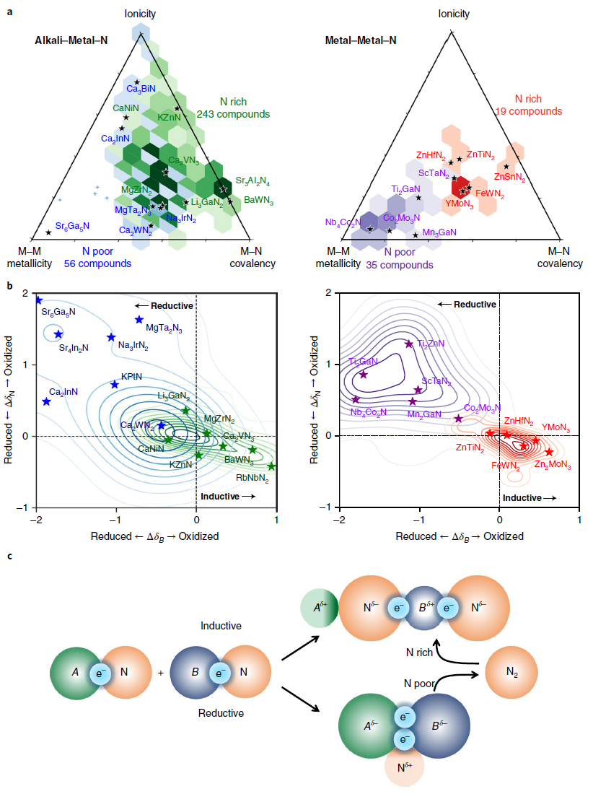
Building a great data figure
Submitted September 2018

Slide 23
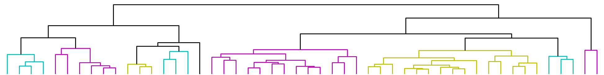
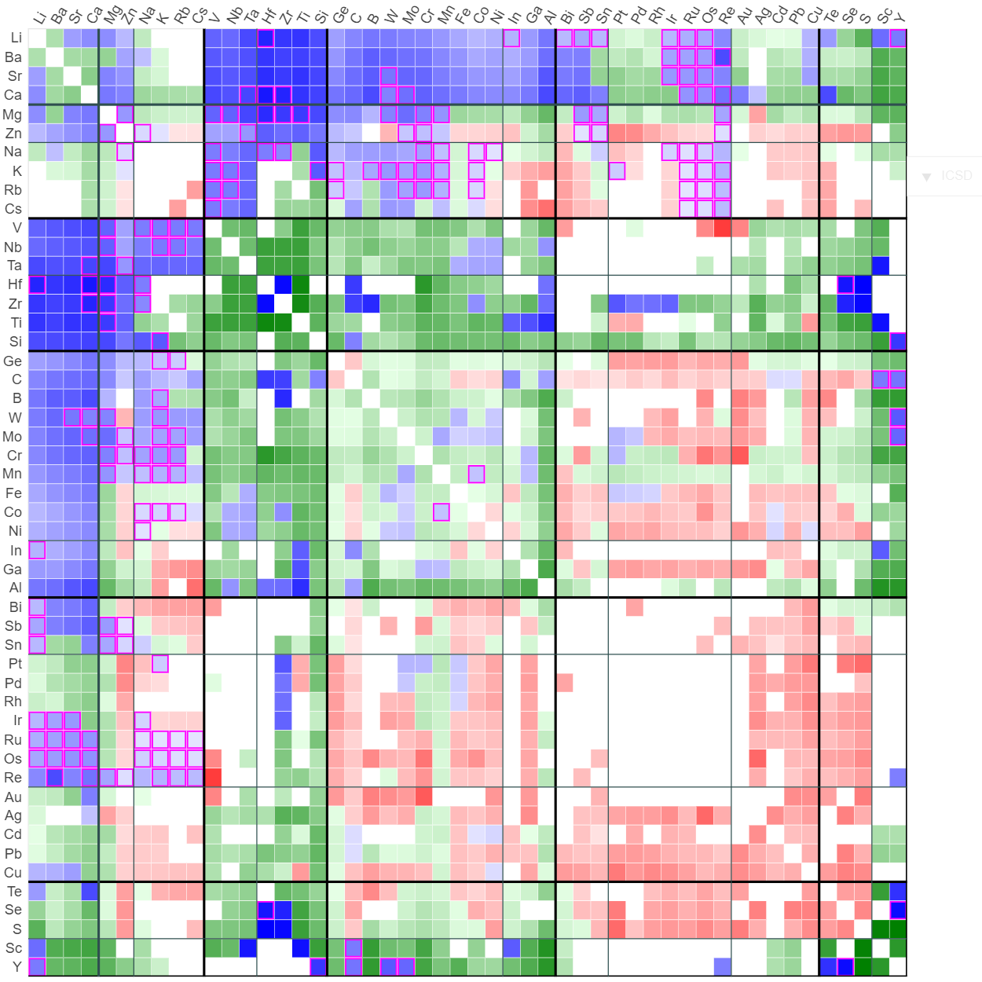
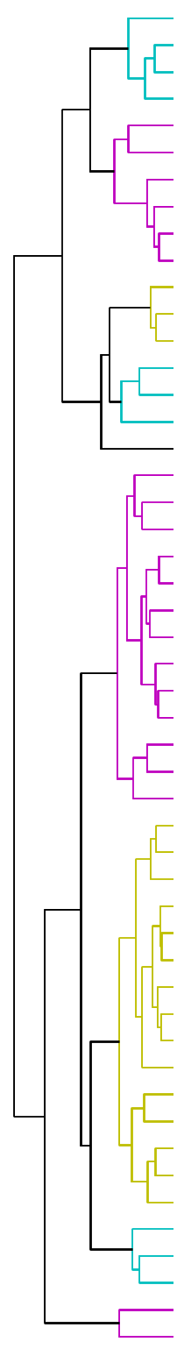
A Map of the Inorganic Ternary Metal Nitrides
Blue (281)
Stable Ternary Nitride
Magenta (92)
New Stable Ternary
Green (420)
Metastable ternary
where ΔH_{f} < 0
Red (261)
Metastable ternary
where ΔH_{f} > 0
White
No likely substitution
Grayscale
“Depth” of ternary hull
Interactive @ wenhaosun.github.io/TernaryNitridesMap.html
W. Sun et al, Nature Materials (2019)

Slide 24
Most stable
ternary nitrides are
Alkali-Metal-Nitrides
Most TM-TM-Nitrides are metastable
w.r.t binaries
Why?

Slide 26
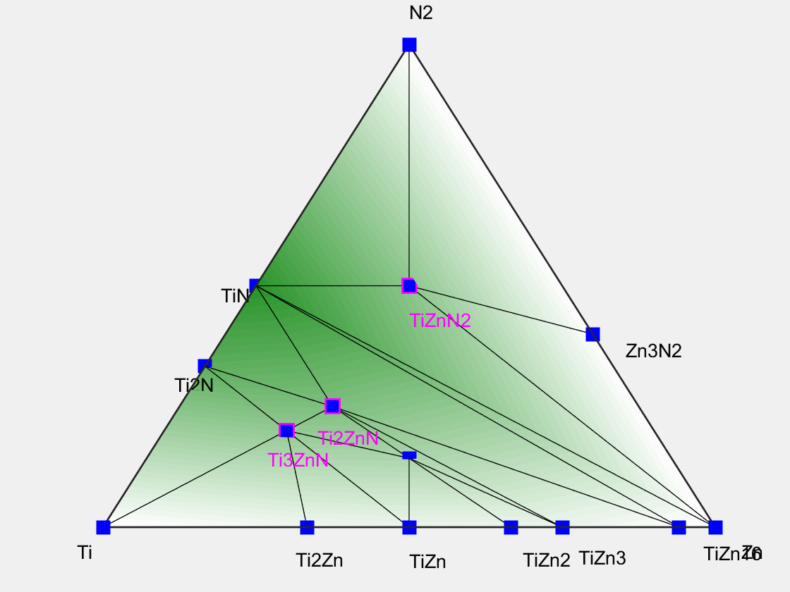

Slide 28
What drives the stability of a ternary metal nitride?
ΔE_{Ternary} = E_{A-B-N} – E_{A-N} – E_{B-N}
N₂
A
B
Formation
Energy

Slide 29
What drives the stability of a ternary metal nitride?
ΔE_{Ternary} = E_{A-B-N} – E_{A-N} – E_{B-N}
N₂
Thermochemical
competition
w/ binaries
Depth of A-N
binary hull
A
B
Formation
Energy

Slide 30
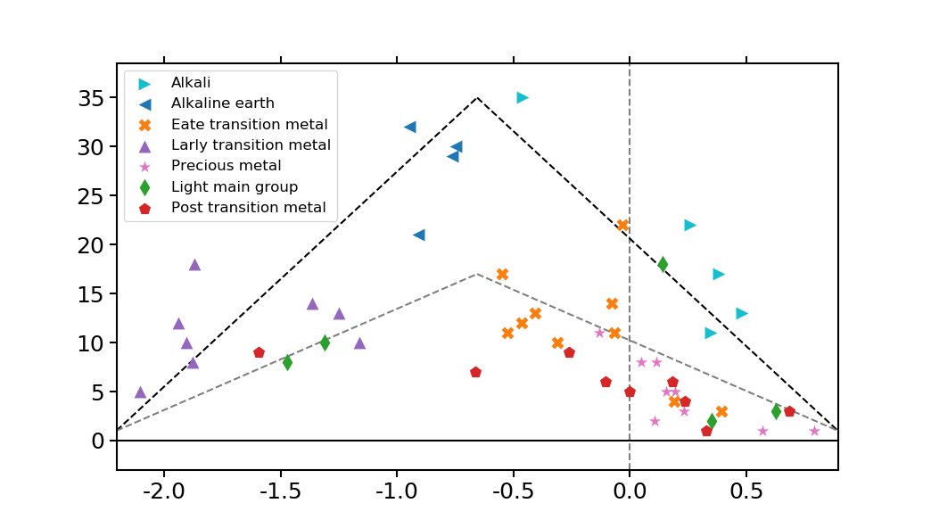
Thermochemical competition w/ binaries
March 2016
Li
Ca
Sr
Ba
Mg
Zn
Na
Stable Ternary Spaces
Zr
Mo
C
K
Mn
Co
Hf
Ta
Nb
W
Cs
Re
Ni
Rb
Ti
Al
V
Cr
Fe
Os
Ru
Sc
Y
Si
Ge
Ir
Sb
Pt
B
Ga
In
Bi
Se
Te
Sn
Cu
Cd
Rh
Pd
S
Pb
Ag
Au
Depth of the Binary Hull (eV/atom)
M-N bonds are very strong
Intermediate
M-N bonds are weak
May bond too strongly to the metal to form ternaries.
Good to form ternaries nitrides with
Nitrides unlikely to form in this chemistry
W. Sun et al, Nature Materials (2019)

Slide 31
What drives the stability of a ternary metal nitride?
ΔE_{Ternary} = E_{A-B-N} – E_{A-N} – E_{B-N}
N₂
Thermochemical
competition
w/ binaries
Depth of A-N
binary hull
A
B
Formation
Energy
Electronic Interaction of A and B in ternary

Slide 32
Submitted September 2018
Scatterplot + Histogram in ternary
metallicity/ionicity/covalency plot
Change in ionicity of the B and the N ion in an A-B-N ternary
Cartoon showing electron
redistribution in two different
types of nitride bonding

Slide 33
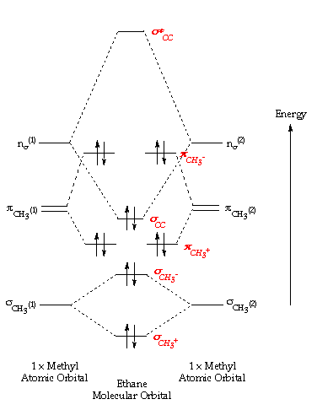
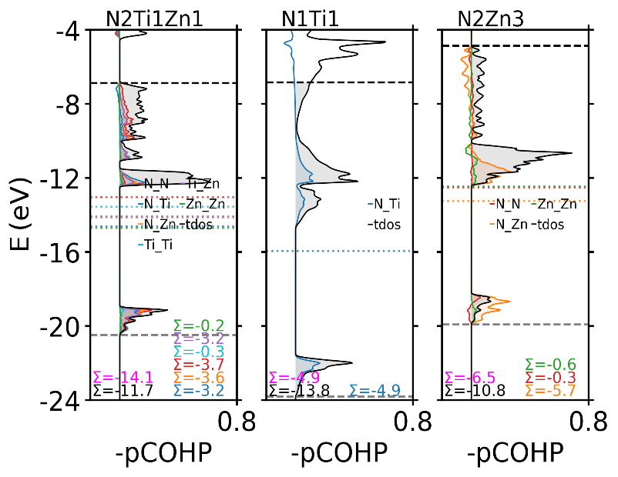
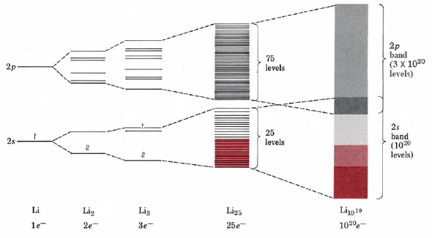


Chemical Bonding in the Solid-State
November 2016
ZnTiN₂
Molecular
Orbital Theory
Solid-State Bonding
Christopher Bartel + Aaron Holder

Slide 34
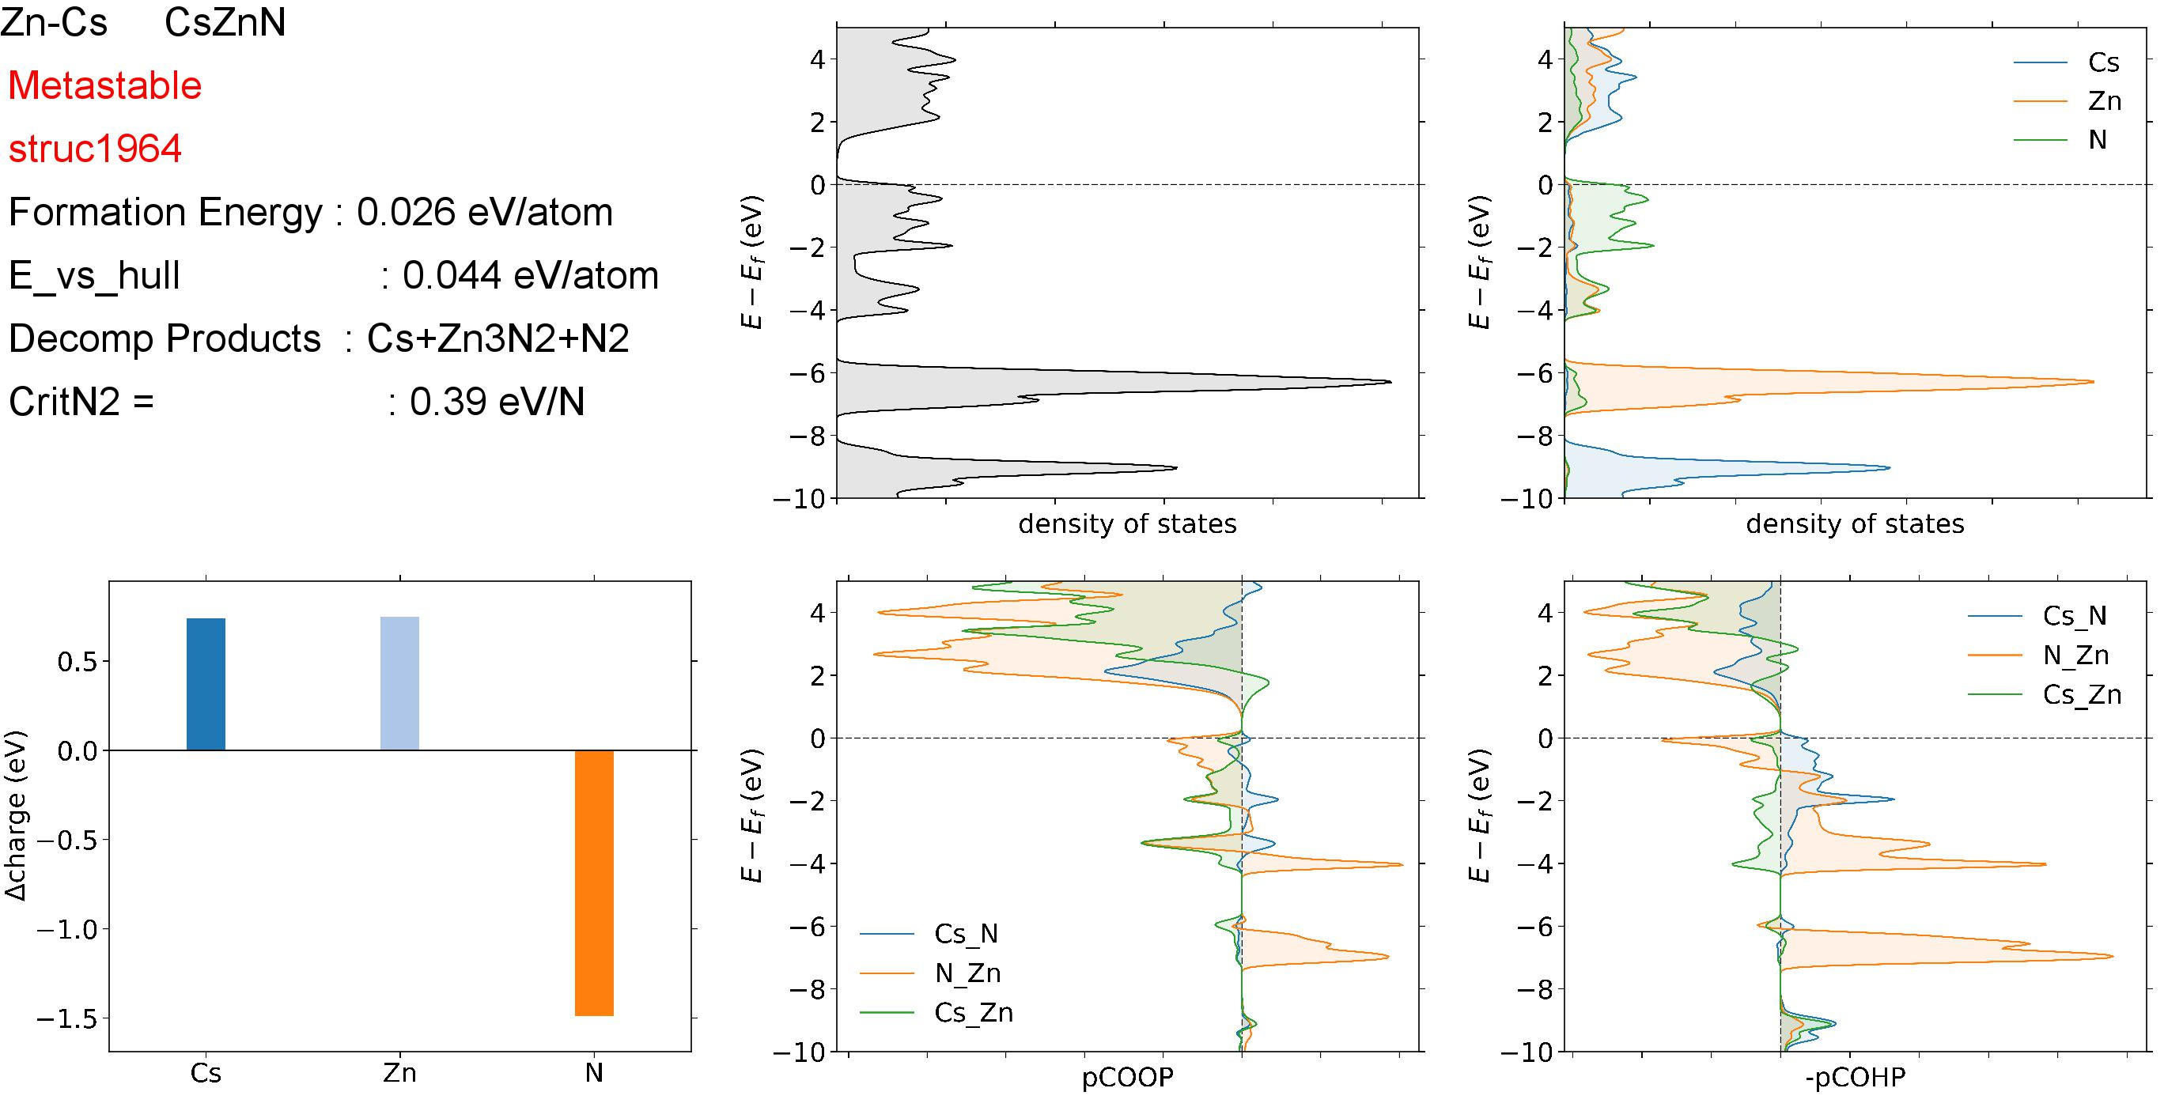
June 2017
I stared at hundreds of these figures
Sorted by stability, sorted by chemistry, etc.

Slide 35
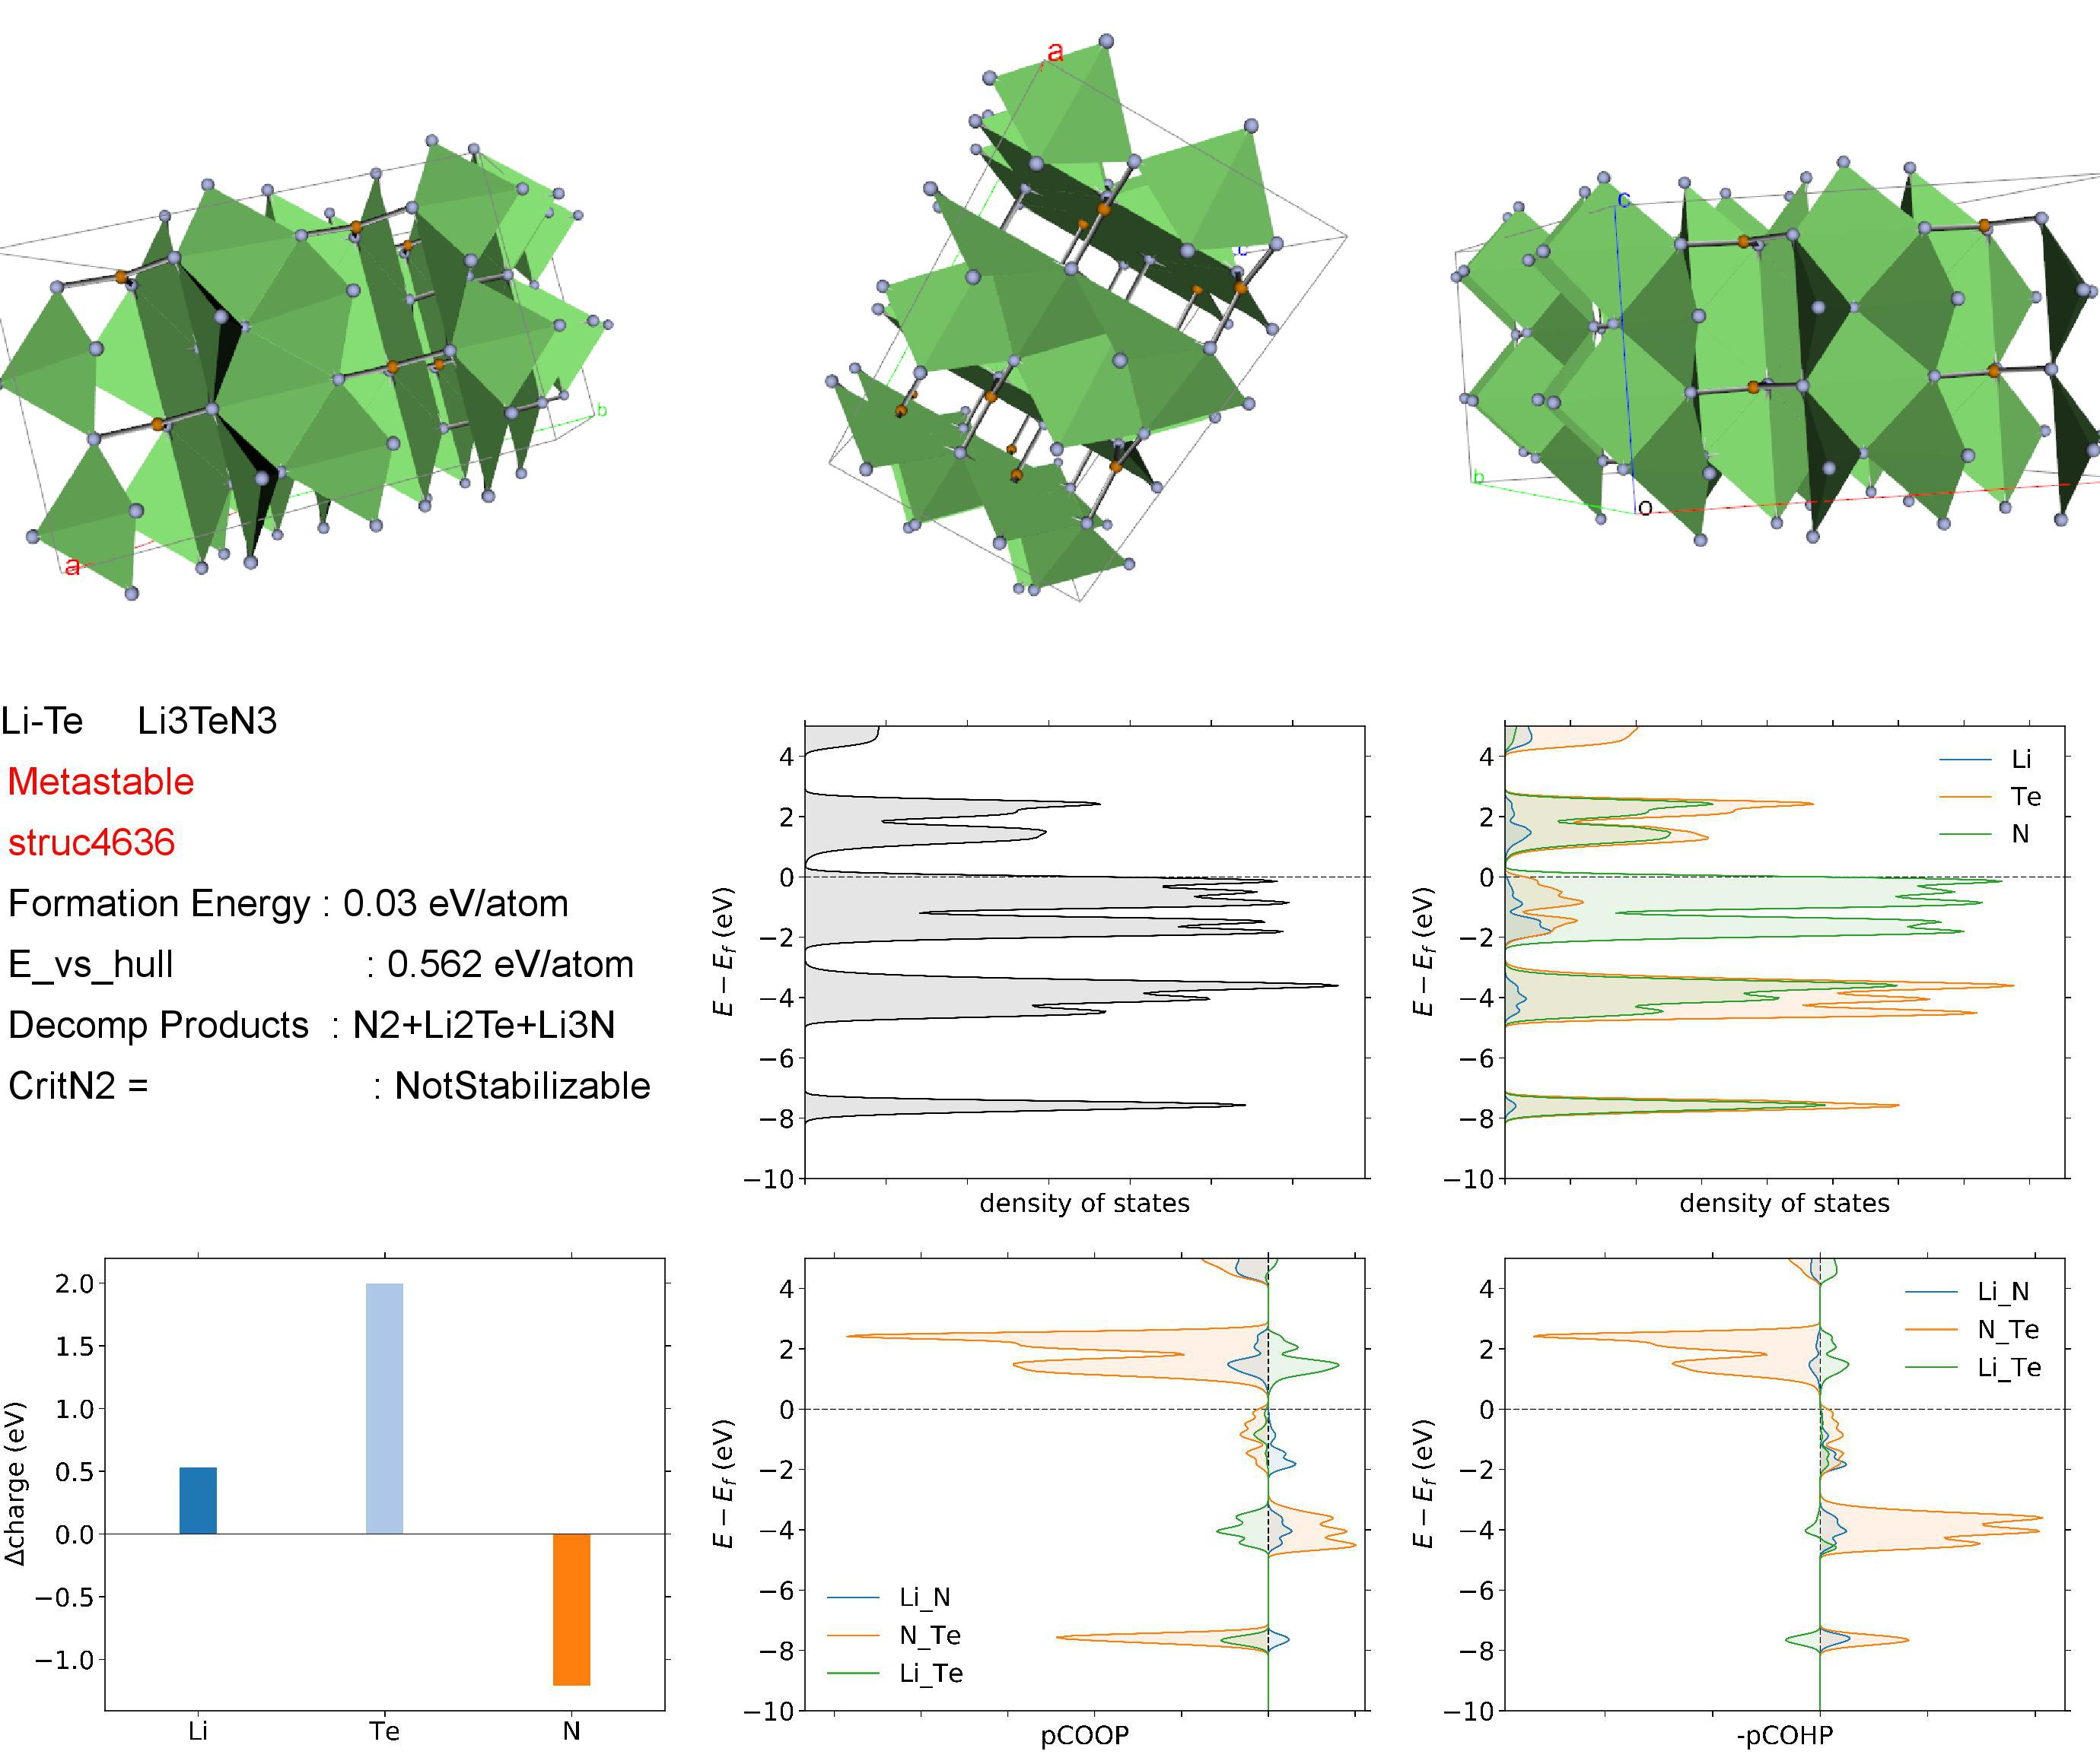
September 2017
Maybe I should include structure?

Slide 36
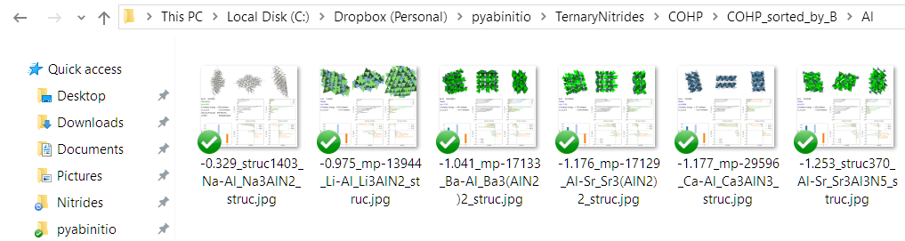
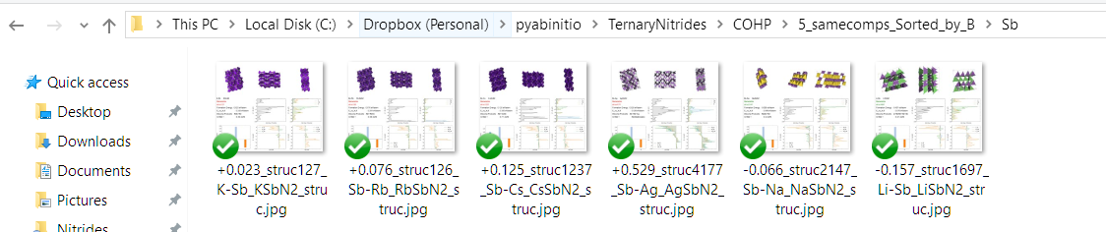
September 2017

Slide 37
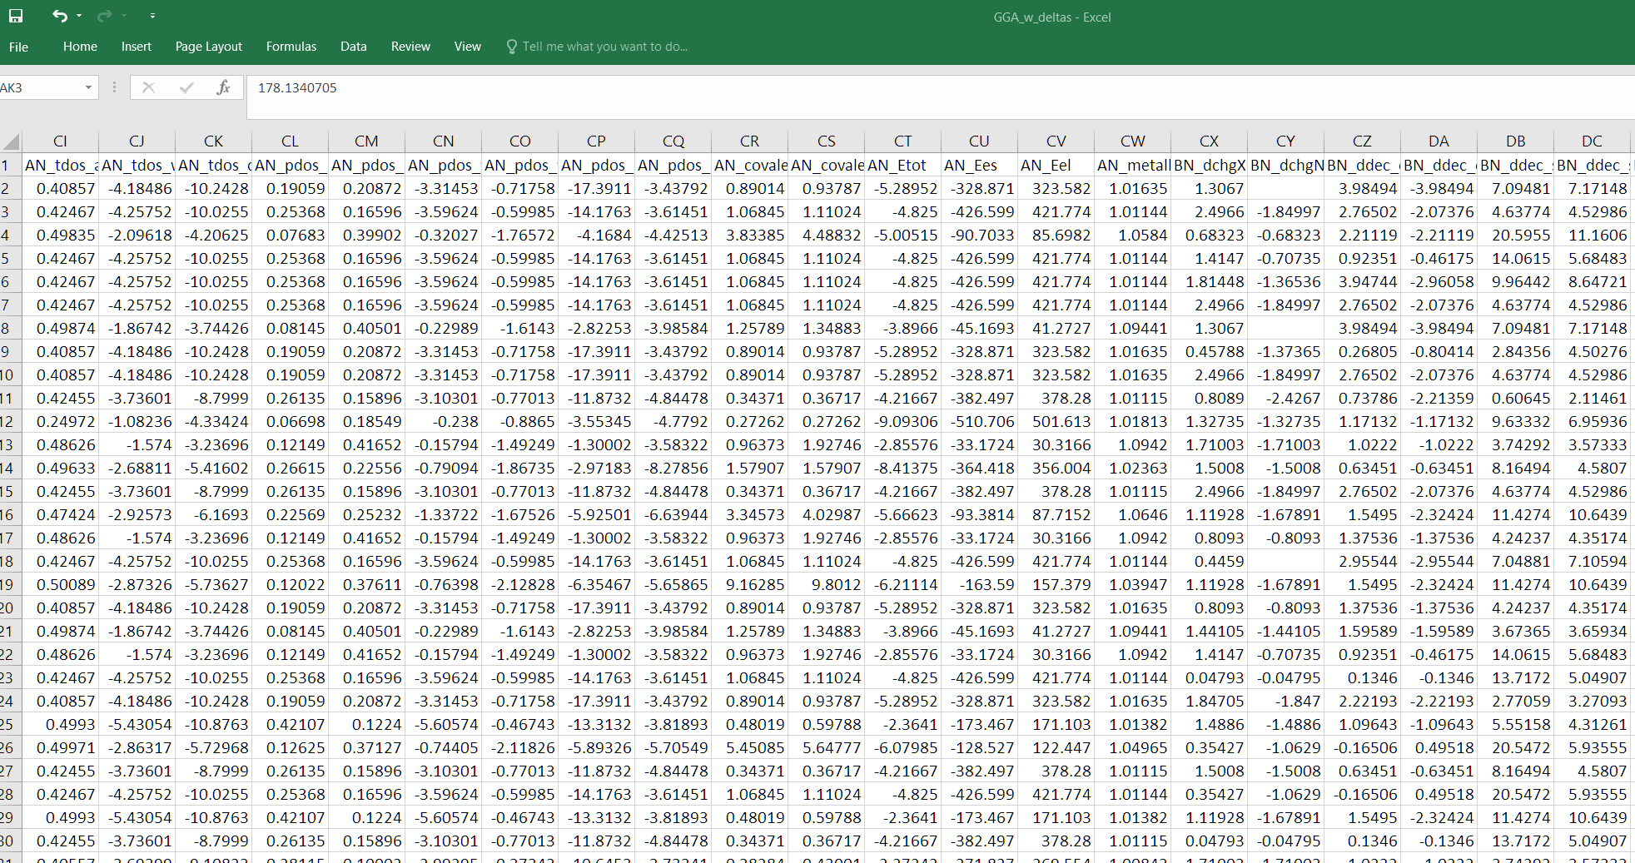
Hypothesis Discovery in the Large Dataset
October 2017
223 Data Category Columns
650 entries Stable and Metastable
140,000 pieces of data
We can do:
Scatterplots
Machine-Learned Hypothesis Discovery
But both need chemical intuition to drive it / interpret it

Slide 38
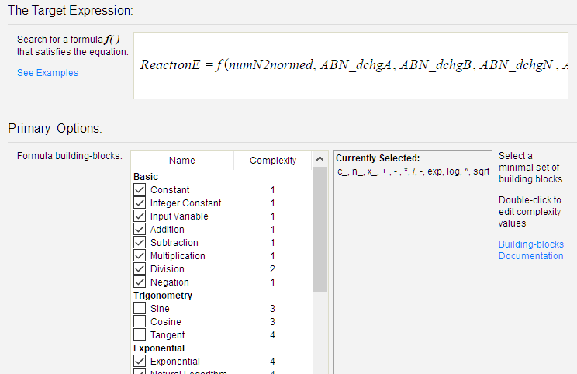
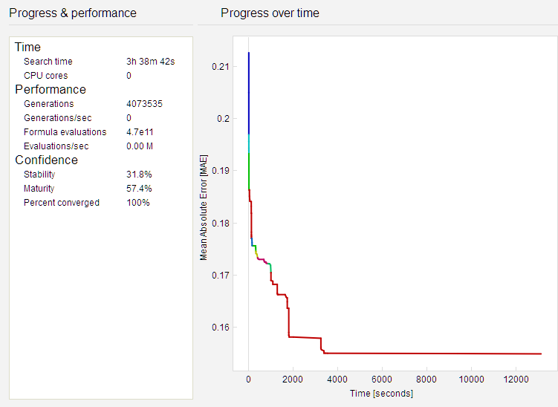
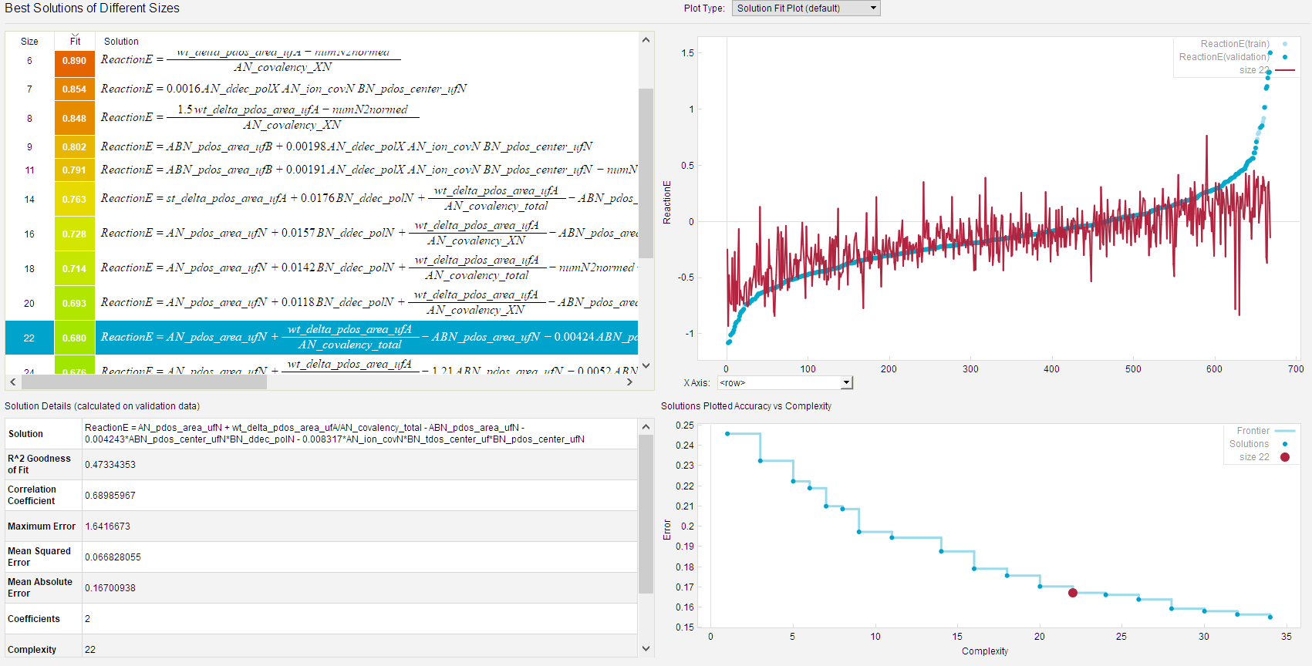
Eureqa uses genetic algorithms to find trends in large datasets
October 2017

Slide 39
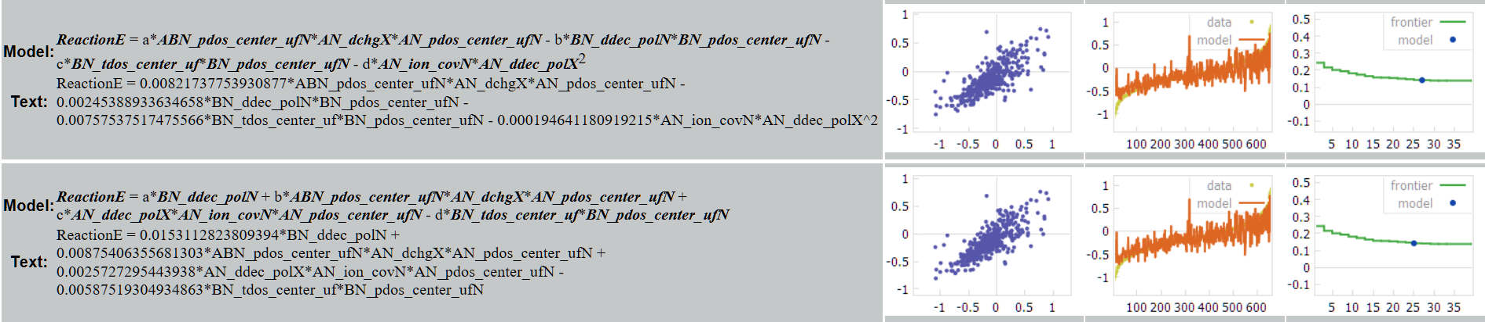
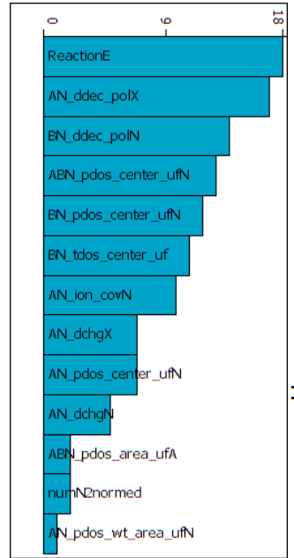
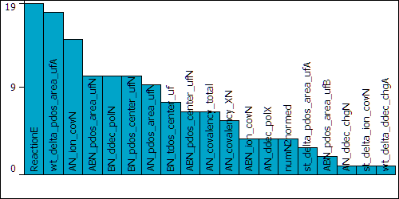
Example Fitted Equations
October 2017
When Fit without Deltas
When Fit with Deltas
Reaction energy is strongly dependent on :
1.) AN_ddec_polX*AN_ion_covN. Polarizability of Metal in A-N * Ionicity of A-N
2.) ABN_pdos_center_ufN*BN_ddec_polN
Nitrogen PDOS center in Ternary * Polarizability of N in B-N
3.) BN_tdos_center_uf*BN_pdos_center_ufN Center of B-N total DOS * Center of Nitrogen PDOS in B-N
4.) BN_ddec_polN*BN_pdos_center_ufN
BN Polarizability of Nitrogen * Center of Nitrogen PDOS in B-N
In AN, polarizability of metal is important
In BN, polarizability of nitrogen is important
Why? Still don’t know yet

Slide 40
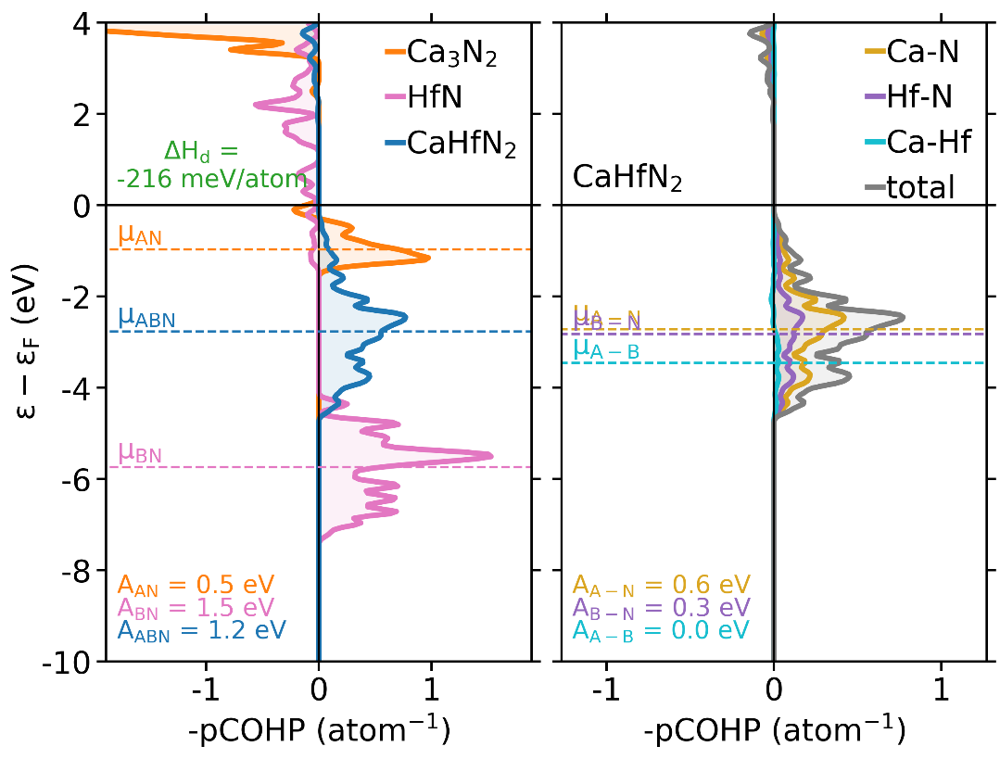
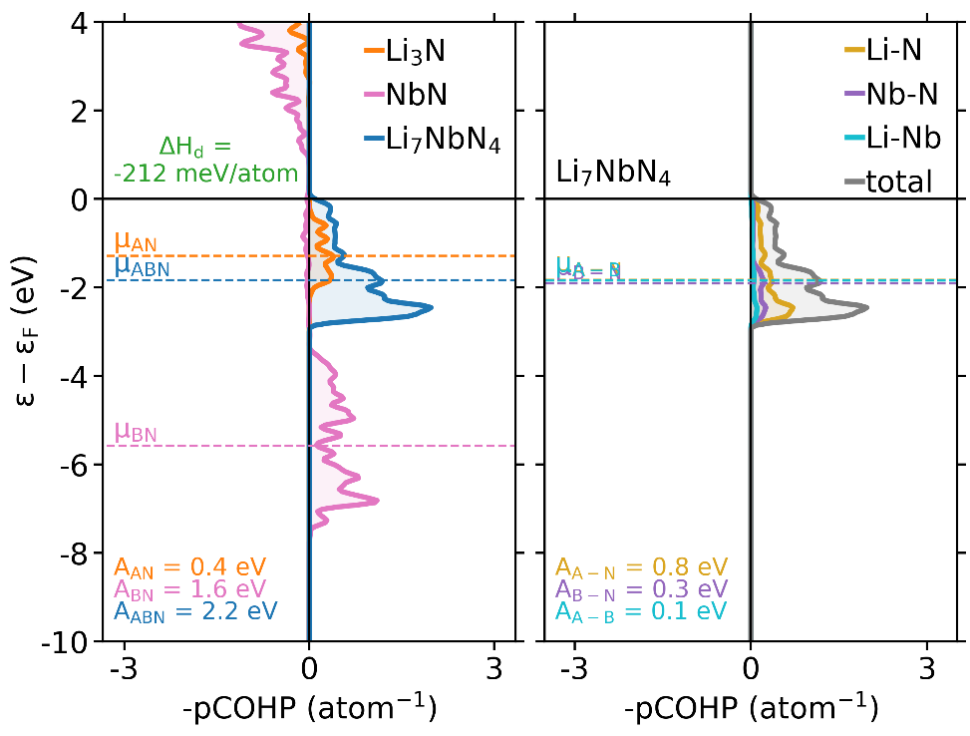
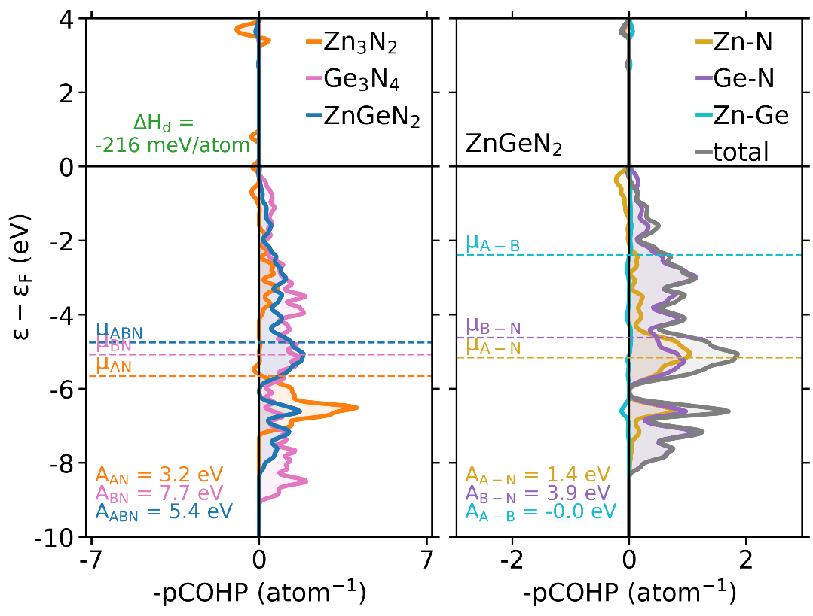
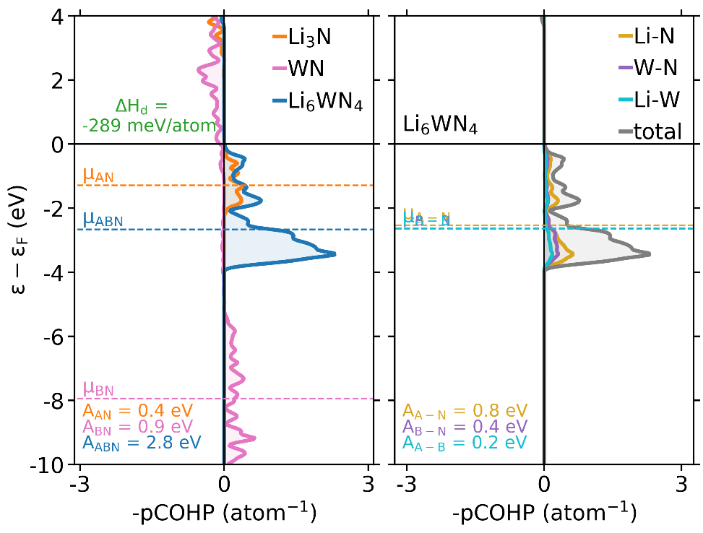
“Reaction COHPs” From A-N + B-N → A-B-N
December 2017

Slide 41
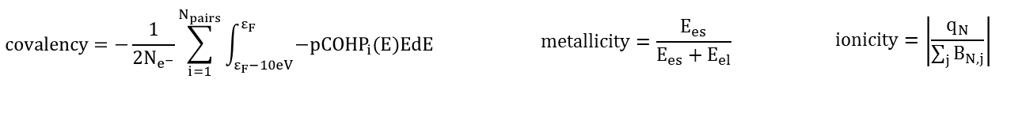
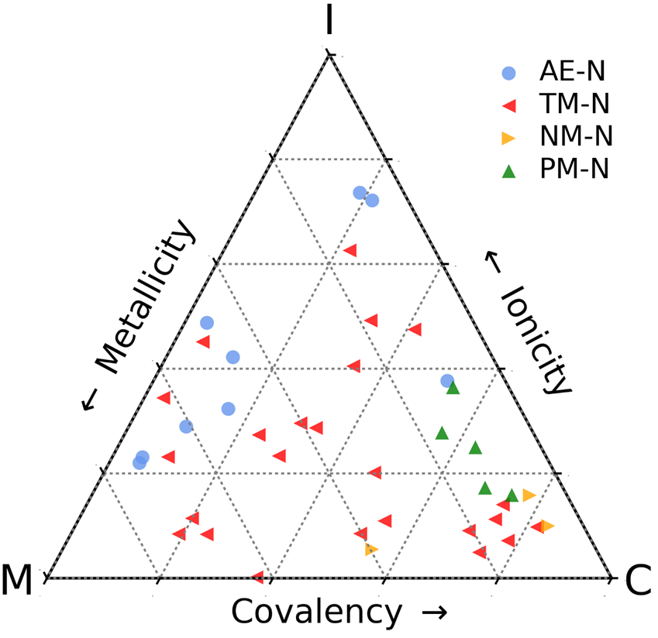
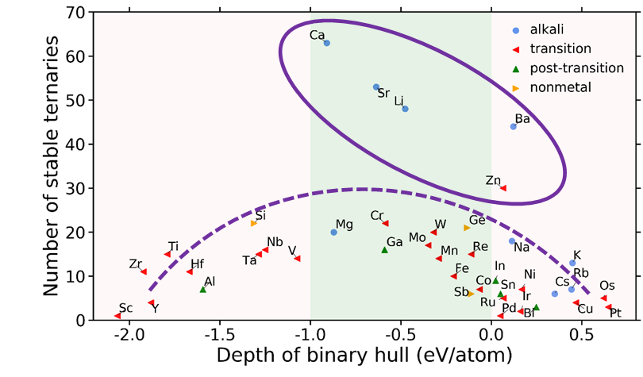
December 2017
Mapping stable nitrides by covalent, ionic, and metallic contributions
Mapping the binary nitrides onto bonding picture reveals natural groupings
Notes:
Left figure takeaways:
-AENs are very non-covalent (except one – Mg3N2) compared with the others
Right figure takeaways:
-Most stable ternaries have AE
-AETMN by far the most common type of ternary
Left and right together:
-AETMNs are formed by increasing the covalency relative to the AENs

Slide 42
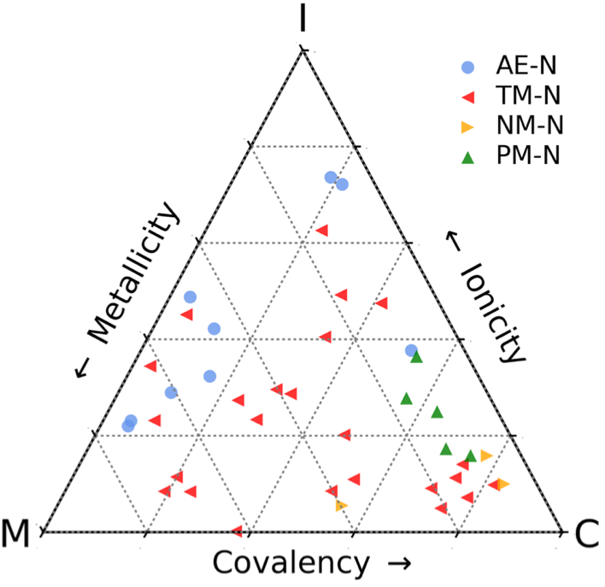
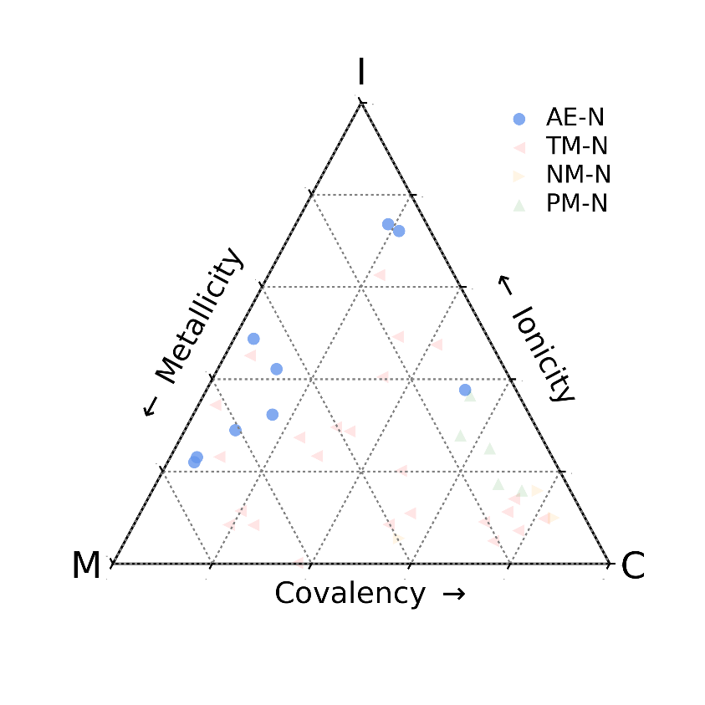
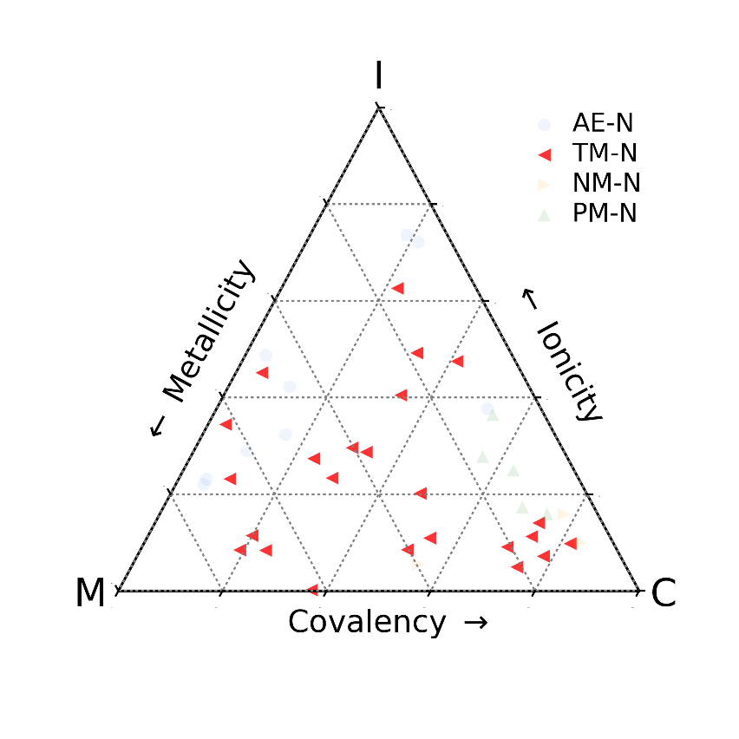
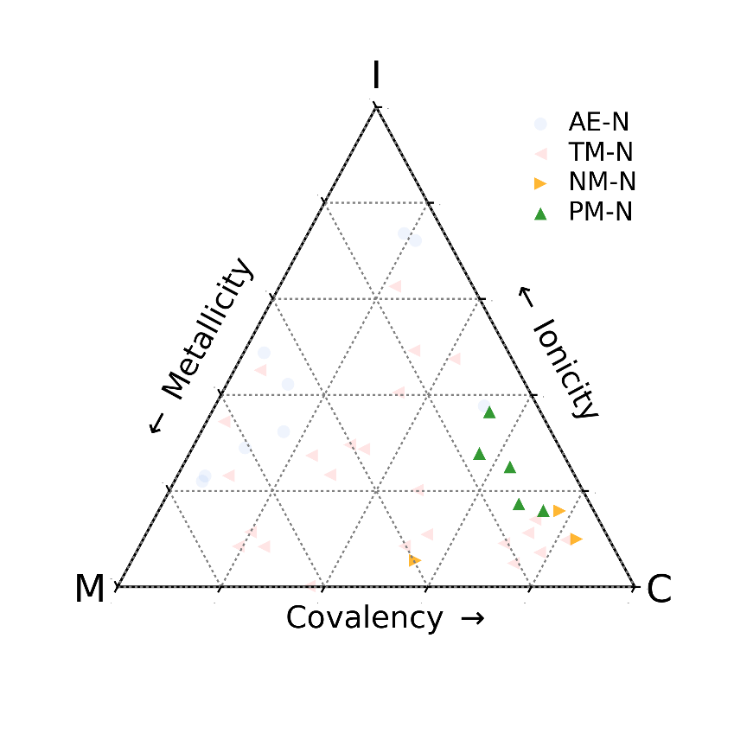
December 2017
Mapping stable nitrides by covalent, ionic, and metallic contributions
Alkali nitrides (e.g., Ca₃N₂)
Non-covalent (ionic/metallic)
TM nitrides (e.g., TiN)
Non-ionic (metallic/covalent)
P-block nitrides (e.g., Si₃N₄)
Non-metallic (covalent/ionic)
Notes:
Left figure takeaways:
-AENs are very non-covalent (except one – Mg3N2) compared with the others
Right figure takeaways:
-Most stable ternaries have AE
-AETMN by far the most common type of ternary
Left and right together:
-AETMNs are formed by increasing the covalency relative to the AENs

Slide 43
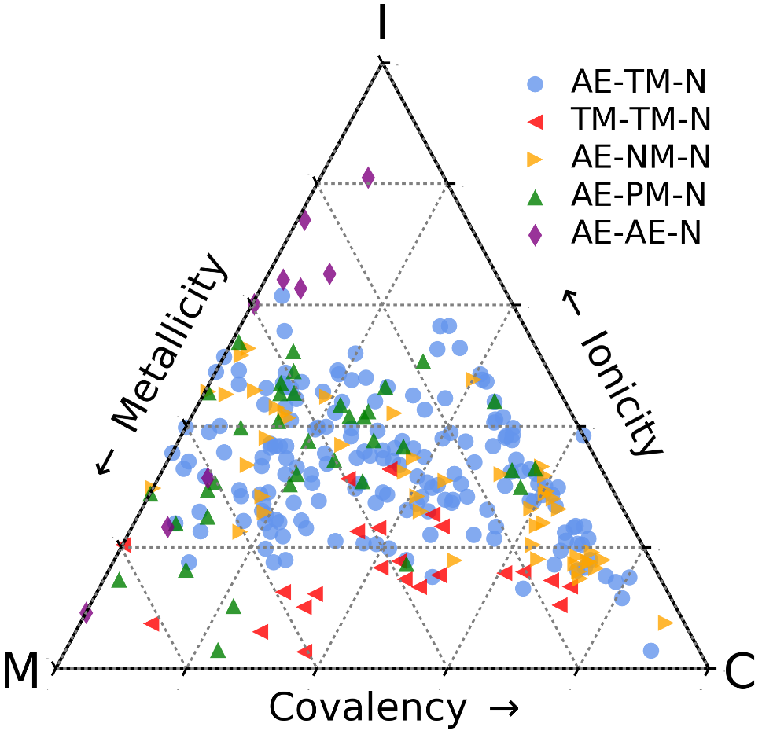
December 2017
Mapping stable nitrides by covalent, ionic, and metallic contributions
Notes:
Left figure takeaways:
-AENs are very non-covalent (except one – Mg3N2) compared with the others
Right figure takeaways:
-Most stable ternaries have AE
-AETMN by far the most common type of ternary
Left and right together:
-AETMNs are formed by increasing the covalency relative to the AENs

Slide 44

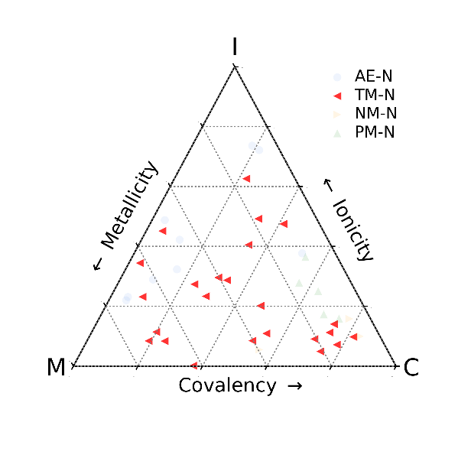
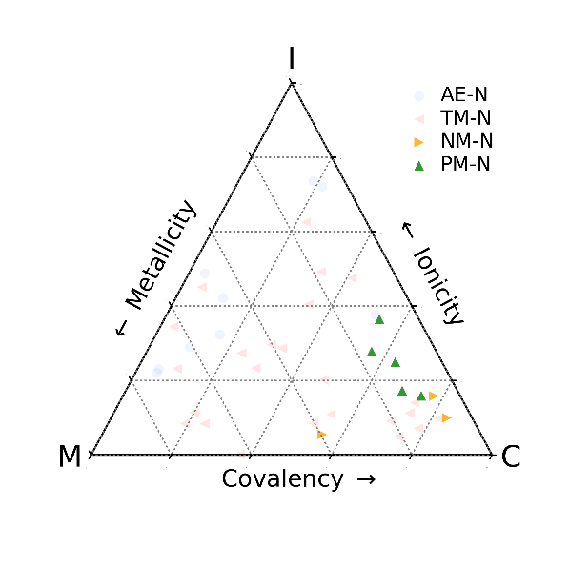
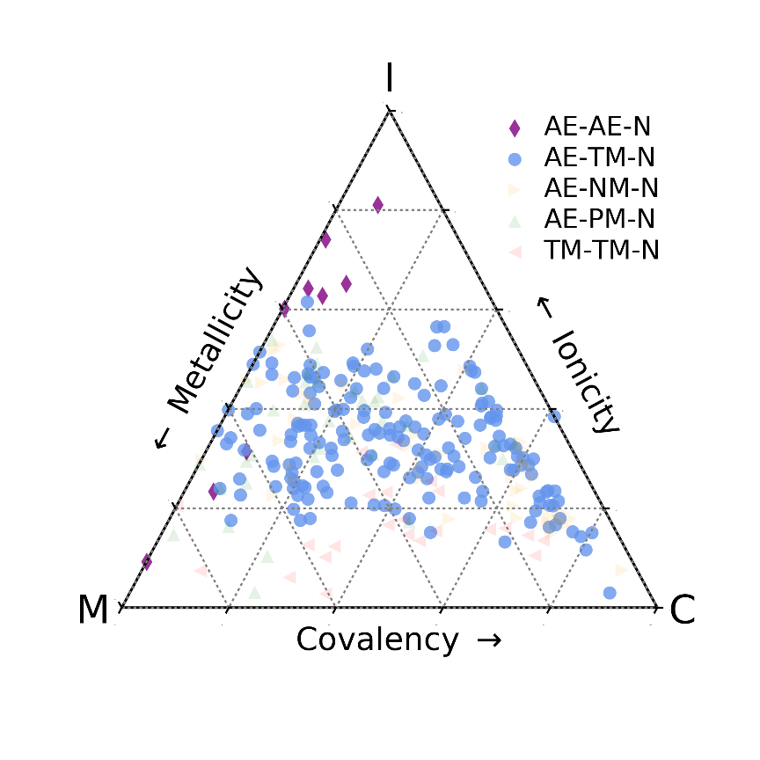
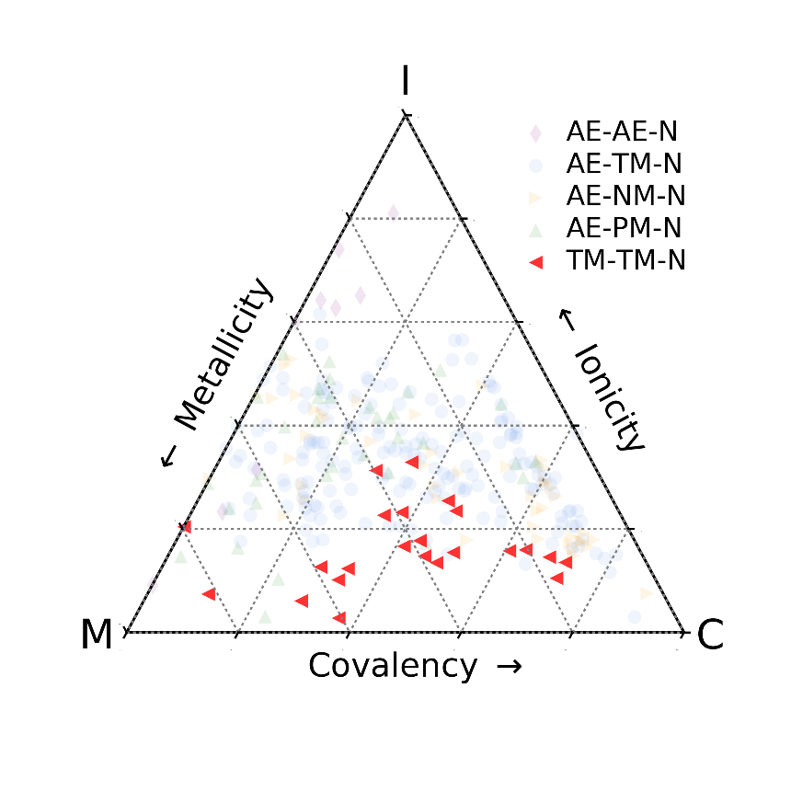
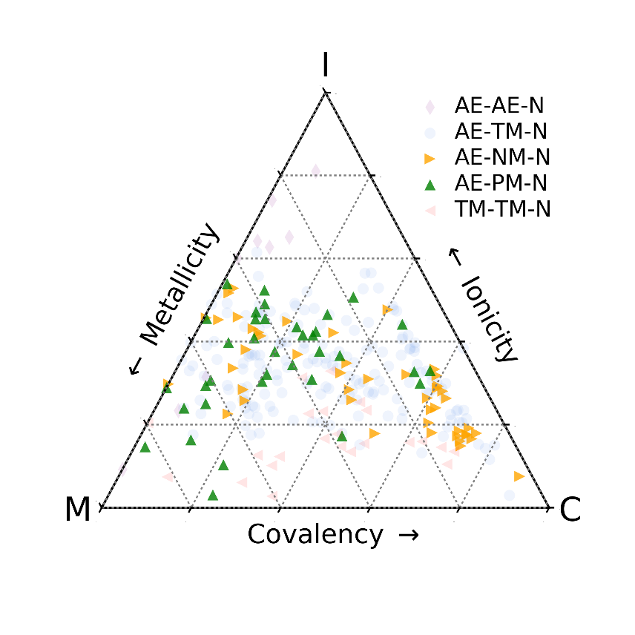
December 2017
How are ternaries stabilized relative to binaries?
AE get more covalent
TM get more metallic
p-block get more ionic
Notes:
Left figure takeaways:
-AENs are very non-covalent (except one – Mg3N2) compared with the others
Right figure takeaways:
-Most stable ternaries have AE
-AETMN by far the most common type of ternary
Left and right together:
-AETMNs are formed by increasing the covalency relative to the AENs

Slide 45
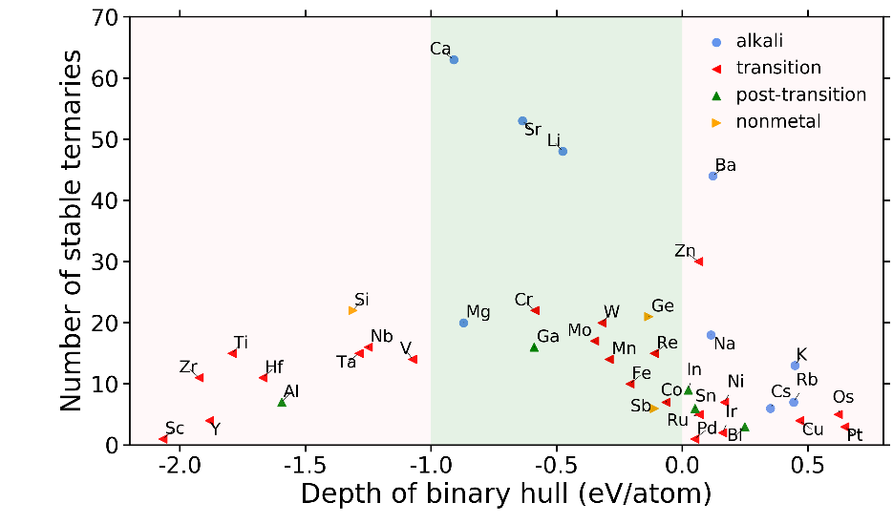
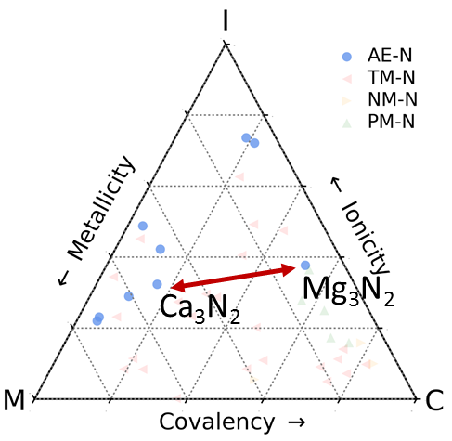
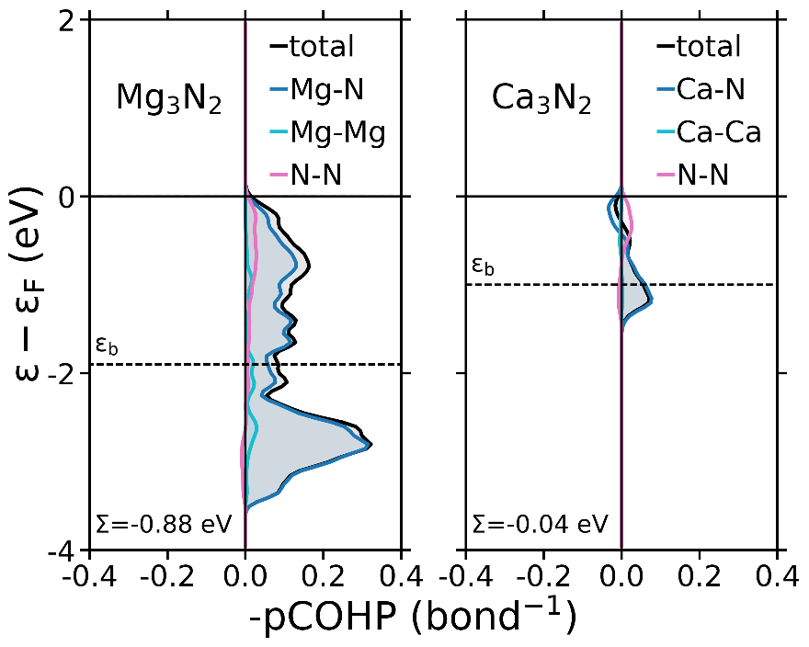
December 2017
Presence of Ca-based ternaries rationalized via electronic frustration
Frustration in Ca₃N₂ leaves ample room to improve bonding in ternary

Slide 46

December 2017
Presence of Ca-based ternaries rationalized via electronic frustration
Frustration in Ca₃N₂ leaves ample room to improve bonding in ternary

Slide 47
Hypothesis Discovery in the Large Dataset
December 2017
223 Data Category Columns
650 entries Stable and Metastable
140,000 pieces of data
We can do:
Scatterplots
Machine-Learned Hypothesis Discovery
But both need chemical intuition to drive it / interpret it

Slide 48


MN + AN generally increases the oxidation state of the M.
December 2017
Gerd suggested that the addition of AN to a MN adds more N, which gives more N p-states to hybridize, and then the A provides the electrons to populate those states.

Slide 49


Can make PairPlots, scatterplots for multivariables

Slide 50

Does B-N form a covalent framework, that is then stabilized by ionic A?
REALLY CRUCIAL FIGURE FOR ME

Slide 51





February 2018
Binary references
INCREASING NITROGEN CONTENT →
INCREASING NITROGEN CONTENT →
Black tCOHP sigma is about the same for all ternaries
Pink sigma (mostly) goes down as you go to the right – is that the sum?
Q: Does deeper bonding = stronger bonds?
Stable: Ti3Zn3N mp-697075 -0.755017627126 -0.012254170119
Stable: Ti3ZnN mp-1014257 -0.971667216476 -0.030596497
Stable: Ti2ZnN mp-1014227 -1.15424461268 -0.0348438860417
Stable: TiZnN2 struc771 -1.03634990036 -0.06905719249

Slide 52
February 2018
Binary references
INCREASING NITROGEN CONTENT →
INCREASING NITROGEN CONTENT →
Only one with N-N bonding (Red)
Lots of orange (Zn-N) and blue (Ti-N) character as well, compared to others
These bonds are very strong, compared to M-M bonding, in just this compound, but also in the other compounds
Even though DOS is not as deep as the others, the occupation of the DOS is more significant (? I think)? More covalency?

Slide 53
February 2018
Binary references
INCREASING NITROGEN CONTENT →
INCREASING NITROGEN CONTENT →
In general, it seems that the magnitude of M-M bonding is weaker than the magnitude of M-N bonding.
M-M ~-1 to -2.
M-N ~-3 to -4
Also, N-states are deeper in the density of states.

Slide 54
February 2018
Binary references
INCREASING NITROGEN CONTENT →
INCREASING NITROGEN CONTENT →
Can we make new data-plots for Sigma, and Sigma ratios? Questions I’m interested in:
Are M-M bonds generally weaker than M-N bonds?
Does more M-N character correspond to a higher pink/black ratio?
(Is the ratio between pink and black COHP meaningful?)
Can we plot the ratio between Pink and Black COHP for N-poor → N-rich?

Slide 55

February 2018
Seaborn sns.displot
Something like this.
As you go N-rich:
The pink/black ratio goes up.
M-N bonding dominates the Pink
M-M bonding decreases
Probability Distribution
100%
Pink Sigma / Black Sigma Ratio
Ratio compared to BlackSigma
Probability Distribution
M-N sigma to Pink sigma Ratio
M-M
bond centers
M-M sigma to Pink sigma Ratio
0%
M-N bond
centers
N-poor
N-rich
Energy w.r.t Fermi? Reference?
I think for now, we can do a scatterplot for each datapoint.
E.g., a datapoint for , M-Msigma / BlackSigma
and maybe then put eye-guides lines through it?
Data from 900 cohps

Slide 56







Energy and bond partitioning
March 2018
$E_{electronic}$contains the information about localizing electrons into ionic (isotropic) and covalent (anisotropic) bonds
One particle bands structures do not give total energies – missing electrostatics for understanding bonding and stabilization
One particle bands structures do not give total energies
Metallic electrostatic energy
Credit to:
Christopher Bartel
Aaron Holder
Integrated -COHP is a covalent bond index, describes optimization of pair interactions

Slide 57


March 2018
Blue means E_{RXN} < 0 , Red means E_{RXN} > 0
RXN Energy = E_{ABN} – N_{AN}E_{AN} – N_{BN}E_{BN} (+/- N_{N2}E_{N2})
E_{AN} and E_{BN} are deepest binary phase in A-N and B-N hull
Positive or Negative RXN energy does not imply hull stability

Slide 58



March 2018
Alkali-N gain stability

Slide 59

March 2018
Alkali-N gain stability

Slide 60

March 2018
Alkali-N gain stability

Slide 61




Metal-N gain stability
March 2018

Slide 62


Metal-N gain stability
March 2018

Slide 63






March 2018

Slide 64
Chemical Bonding in the Solid-State
May 2018
Molecular
Orbital Theory
Solid-State Bonding

Slide 65

Chemical Bonding in the Solid-State
May 2018
(Net charge divided by summed bond order)
Ionicity
x
M-M Bonds
A-A
B-B
A-B
M-N Bonds
A-N
B-N
N-N

Slide 66

Chemical Bonding in the Solid-State
May 2018
(Net charge divided by summed bond order)
Ionicity
900 COHP calculations
M-M Bonds
A-A
B-B
A-B
M-N Bonds
A-N
B-N
N-N

Slide 67

Nitrogen-Rich vs. Nitrogen-Poor Ternaries
May 2018
Alkali-Metal-Nitride
Metal-Metal-Nitride
Alkali-
MainGroup
Nitrides
Nitrogen-Rich: Ca₃N₂ + Mo³⁺N + 0.5 N₂ → Ca₂Mo⁵⁺N₃
Stoichiometric: Li₃N + GaN → Li₃GaN₂
Nitrogen-Poor: 3CoN + 3FeN → Co₃Fe₃N + 2.5 N₂
Determined by: (A-N)_{Deepest} + (B-N)_{Deepest} ± N₂ → (A-B-N)_{Deepest}

Slide 68


May 2018
Alkali-Metal-Nitride
Metal-Metal-Nitride
Stoichiometric +
Nitrogen-Rich
Nitrogen-Poor
Bonding
Integral
Ratio
Integrated Bond Center
Similar strength
Between M-N/M-M
M-N bonds
stronger than
M-M bonds
N-poor
Nitrogen Excess
N-rich
Probability Distribution
Probability Distribution

Slide 69
What drives the stability of a ternary metal nitride?
ΔE_{Ternary} = E_{A-B-N} – E_{A-N} – E_{B-N}
N₂
Thermochemical
competition
w/ binaries
Depth of A-N
binary hull
A
B
Formation
Energy
Electronic Interaction of A and B in ternary

Slide 70
Chemical Bonding in the Solid-State
ZnTiN₂
Molecular
Orbital Theory
Solid-State Bonding
Christopher Bartel + Aaron Holder

Slide 71
Chemical Bonding in the Solid-State
ZnTiN₂
(Net charge divided by summed bond order)
Ionicity
x
Covalency
A-N
B-N
N-N
Metallicity
A-A
B-B
A-B
Christopher Bartel + Aaron Holder

Slide 72
Chemical Bonding in the Solid-State
ZnTiN₂
(Net charge divided by summed bond order)
Ionicity
COHPs for stable
ternary nitrides
Covalency
A-N
B-N
N-N
Metallicity
A-A
B-B
A-B
Christopher Bartel + Aaron Holder

Slide 73


Extract Metallicity / Ionicity / Covalency from DFT-computed electron density
Chris Bartel + Aaron Holder
Alkali-Metal-Nitride
Metal-Metal-Nitride
Alkali-Metal-N
TM-TM-N

Slide 74
Extract Metallicity / Ionicity / Covalency from DFT-computed electron density
Chris Bartel + Aaron Holder
Alkali-Metal-Nitride
Metal-Metal-Nitride
Alkali-Metal-N
TM-TM-N
Stable Alkali-Metal-Nitrides are nitrogen-rich, with ionic-covalent bonding.

Slide 75

A
N
A typical structural motif in ternary nitrides is A—N—B
B
A
N
B

Slide 76
Electropositive A gives up electron
e⁻
N
B
A^{δ+}

Slide 77
…and is taken by electrophilic nitrogen anion
Electropositive A gives up electron
e⁻
N
B
A^{δ+}

Slide 78
…and is taken by electrophilic nitrogen anion
Electropositive A gives up electron
e⁻
N^{δ-}
B
A^{δ+}

Slide 79
…and is taken by electrophilic nitrogen anion
… which bonds with more electronegative transition metal B
N^{δ-}
B
A^{δ+}
e⁻

Slide 80
…and is taken by electrophilic nitrogen anion
… which bonds with more electronegative transition metal B
N^{δ-}
A^{δ+}
B^{δ+}
e⁻
Which oxidizes the B metal

Slide 81
N-rich
N₂
N^{δ-}
N^{δ-}
A^{δ+}
B^{δ+}
e⁻
e⁻
Significant B oxidation may
be compensated by extra Nitrogen

Slide 82
Strong Covalent Bonds
[
]
N^{δ-}
N^{δ-}
^{δ-}
A^{δ+}
B^{δ+}
e⁻
e⁻
Strong Ionic Bonds
= Alkali-Metal-Nitride Ceramics with
very negative lattice energies

Slide 83




Why are there so many stable nitrogen-rich ternary Alk-Me-N?
‘Inductive’ Effect
BaZrN₂
Sr₆Cu₃N₅
Most stable
ternary nitrides are
Alkali-Metal-Nitrides
Etourneau, et al. "The role of the inductive effect in solid state chemistry" J. Alloys and Compounds (1992)

Slide 84
Most TM-TM-Nitrides are metastable
w.r.t binaries

Slide 85
“Islands of Stability” within the TM-TM-N space
Most TM-TM-Nitrides are metastable
w.r.t binaries

Slide 86
Extract Metallicity / Ionicity / Covalency from DFT-computed electron density
Chris Bartel + Aaron Holder
Alkali-Metal-Nitride
Metal-Metal-Nitride
Alkali-Metal-N
TM-TM-N
Stable TM-TM-Nitrides are nitrogen-poor, with metal-metal bonding.

Slide 87

Metal-Metal-Nitride
Stable Metal-Metal-Nitrides are metallic and nitrogen-poor
Ionicity
N-Rich
19 compounds
M-M Metallicity
N-Poor
35 compounds
M-N Covalency
A
B
N

Slide 88
Metal-Metal-Nitride
Stable Metal-Metal-Nitrides are metallic and nitrogen-poor
Ionicity
N-Rich
19 compounds
If metal-metal bonds are stronger than metal nitrogen bonds
M-M Metallicity
N-Poor
35 compounds
M-N Covalency
A
B
N

Slide 89
Metal-Metal-Nitride
Stable Metal-Metal-Nitrides are metallic and nitrogen-poor
Ionicity
N-Rich
19 compounds
If metal-metal bonds are stronger than metal nitrogen bonds
M-M Metallicity
N-Poor
35 compounds
M-N Covalency
A
B
e⁻
N^{δ+}
Nitrogen anion can be oxidized

Slide 90
Metal-Metal-Nitride
Stable Metal-Metal-Nitrides are metallic and nitrogen-poor
Ionicity
N-Rich
19 compounds
If metal-metal bonds are stronger than metal nitrogen bonds
M-M Metallicity
N-Poor
35 compounds
M-N Covalency
M^{δ-}
M^{δ-}
e⁻
e⁻
N^{δ+}
Nitrogen anion can be oxidized
Which in turn reduces the metals

Slide 91



Why makes nitrogen-poor ternary M-M-N stable?
NEW: ‘Reductive’ Effect
Infinite Co-Co
Chain
Co₂Mo₃N
Covalent
Mo-N
Network
Oxidizing or removing nitrogen:
Sr₃Ge₂N₂
Infinite Ge-Ge
Chains
→ Reduces transition metals
→ Increases metal-metal bonding
Ionic
Sr²⁺(GeN₂)²⁻
Lattice
W. Sun et al, Nature Materials (In Press)
ArXiv: 1809.09202 (2019)

Slide 92


Nitrogen has electronegativity between carbon and oxygen
Stable Carbide-like Intermetallic Nitrides
Stable Oxide-like Nitride Ceramics
W. Sun et al, Nature Materials (In Press)
ArXiv: 1809.09202 (2019)

Slide 93
Building a great data figure
Submitted September 2018

